Slide 1
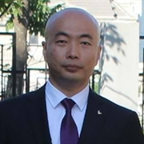
04. ASP.NET Core项目搭建 Resource Model, AutoMapper, FluentValidation
杨旭, 331335713@qq.com
公众号: 草根专栏
Notes:
Be specific and direct in the title. Use the subtitle to give the specific context of the speech.
-The goal should be to capture the audience’s attention which can be done with a quote, a startling statistic, or fact. It is not necessary to include this attention getter on the slide.

Slide 2
今天的内容
Resource Model
AutoMapper
FluentValidation
Notes:
The counterargument should be the most common argument against the topic. The goal for this slide is to address the counterargument in such a way as to actually strengthen the original topic. Be sure to address each piece of evidence against the topic. As you address each piece of evidence elaborate on the text found on the slide. Remember to transition to the final slide, the action step.

Slide 3
Resource Model
Notes:
Dedicate this entire slide to the thesis statement. It is the reason the speech is being given. Use this time to reveal the three main points of the speech (slides 4,5,6) as an overview for the direction of the speech:
-[type main point #1 here]
-[type main point #2 here]
-[type main point #3 here]
Be sure to transition to the first main point and the next slide.

Slide 4
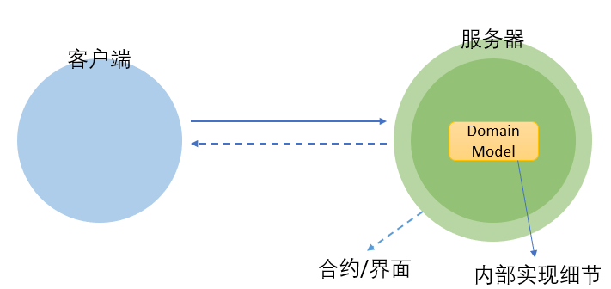
API应该直接返回Entity吗? 不应该
Entity/Domain Model是内部实现细节
合约/接口界面
Notes:
Use the background points to post details that are not common knowledge, or that the audience will need to understand the context of the speech.
-Do not read these main points from the PowerPoint, instead elaborate on these points during the speech.

Slide 5
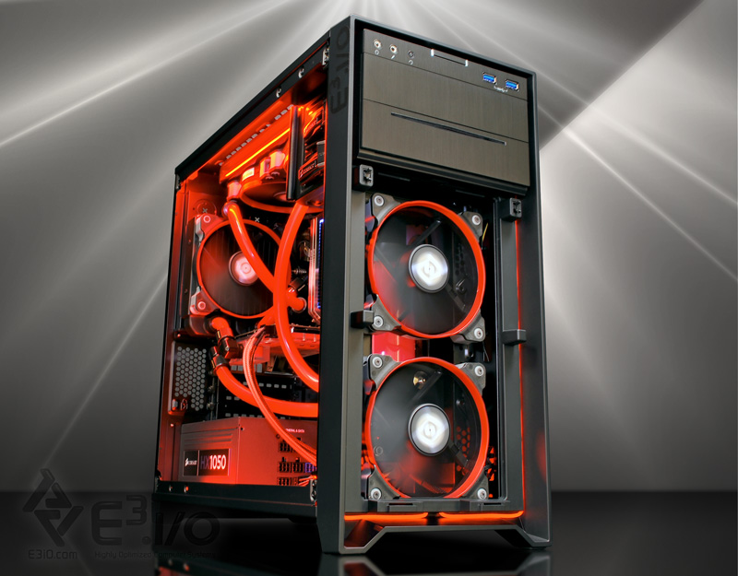
API应该直接返回Entity吗? 不应该
就像PC主机一样
CPU, 内存, 显卡, 主板…是内部实现细节
机箱是公共接口/合约
内部零件可以升级, 机箱接口界面不会改变
Notes:
Use the background points to post details that are not common knowledge, or that the audience will need to understand the context of the speech.
-Do not read these main points from the PowerPoint, instead elaborate on these points during the speech.

Slide 6
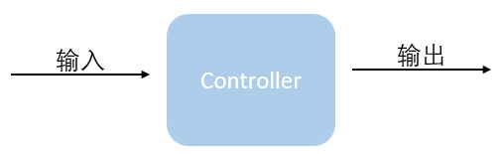
API应该返回另外一个类 资源 Resource
与Entity可能很像.
独立于Entity, 单独进化和改变.
也可以叫做ViewModel, Dto
Notes:
Use the background points to post details that are not common knowledge, or that the audience will need to understand the context of the speech.
-Do not read these main points from the PowerPoint, instead elaborate on these points during the speech.

Slide 7
AutoMapper
Notes:
Dedicate this entire slide to the thesis statement. It is the reason the speech is being given. Use this time to reveal the three main points of the speech (slides 4,5,6) as an overview for the direction of the speech:
-[type main point #1 here]
-[type main point #2 here]
-[type main point #3 here]
Be sure to transition to the first main point and the next slide.

Slide 8
Entity和Resource之间如何映射? AutoMapper
安装Nuget包:
AutoMapper
AutoMapper.Extensions.Microsoft.DependencyInjection
配置映射
可以创建Profile
CreateMap<TSource, TDestination>()
services.AddAutoMapper()
官网:
http://automapper.org/
http://docs.automapper.org/en/stable/index.html
Notes:
Use the background points to post details that are not common knowledge, or that the audience will need to understand the context of the speech.
-Do not read these main points from the PowerPoint, instead elaborate on these points during the speech.

Slide 9
使用AutoMapper
建议注入IMapper
Notes:
Use the background points to post details that are not common knowledge, or that the audience will need to understand the context of the speech.
-Do not read these main points from the PowerPoint, instead elaborate on these points during the speech.

Slide 10
FluentValidation
Notes:
Dedicate this entire slide to the thesis statement. It is the reason the speech is being given. Use this time to reveal the three main points of the speech (slides 4,5,6) as an overview for the direction of the speech:
-[type main point #1 here]
-[type main point #2 here]
-[type main point #3 here]
Be sure to transition to the first main point and the next slide.

Slide 11
为什么使用FluentValidation
验证逻辑与业务逻辑分离
灵活, 功能强大
Fluent API, Lambda表达式
Notes:
Use the background points to post details that are not common knowledge, or that the audience will need to understand the context of the speech.
-Do not read these main points from the PowerPoint, instead elaborate on these points during the speech.

Slide 12
FluentValidation
安装Nuget包:
FluentValidation
FluentValidation.AspNetCore
为Resource配置验证器
继承于AbstractValidator
注册到容器: services.AddTransient<>()
官网:
https://fluentvalidation.net/
Notes:
Use the background points to post details that are not common knowledge, or that the audience will need to understand the context of the speech.
-Do not read these main points from the PowerPoint, instead elaborate on these points during the speech.

Slide 13

Day 4

